Slide 1
Learning Graph Neural Networks with Deep Graph Library
Lingfan Yu & Da Zheng & Quan Gan
with DGL Team
http://dgl.ai

Slide 2
Today’s schedule
Introduction to graph representation learning (30 mins)
Deep Graph Library 101 (1 hour 30 mins)
Scale GNN to large graphs (1 hour)
GNN-based recommender system (1 hour)

Slide 3
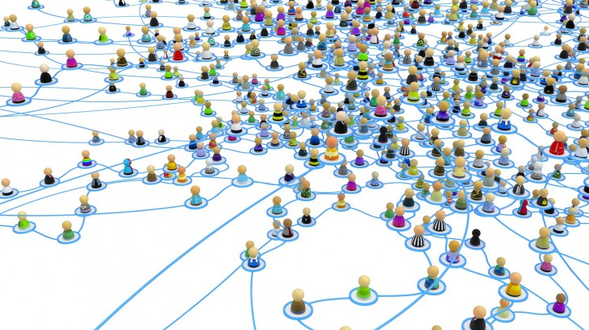
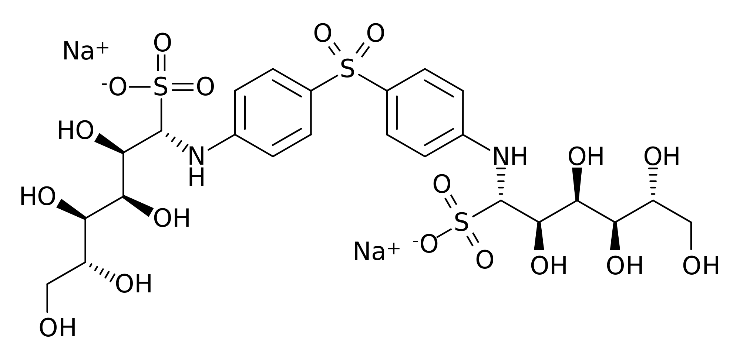
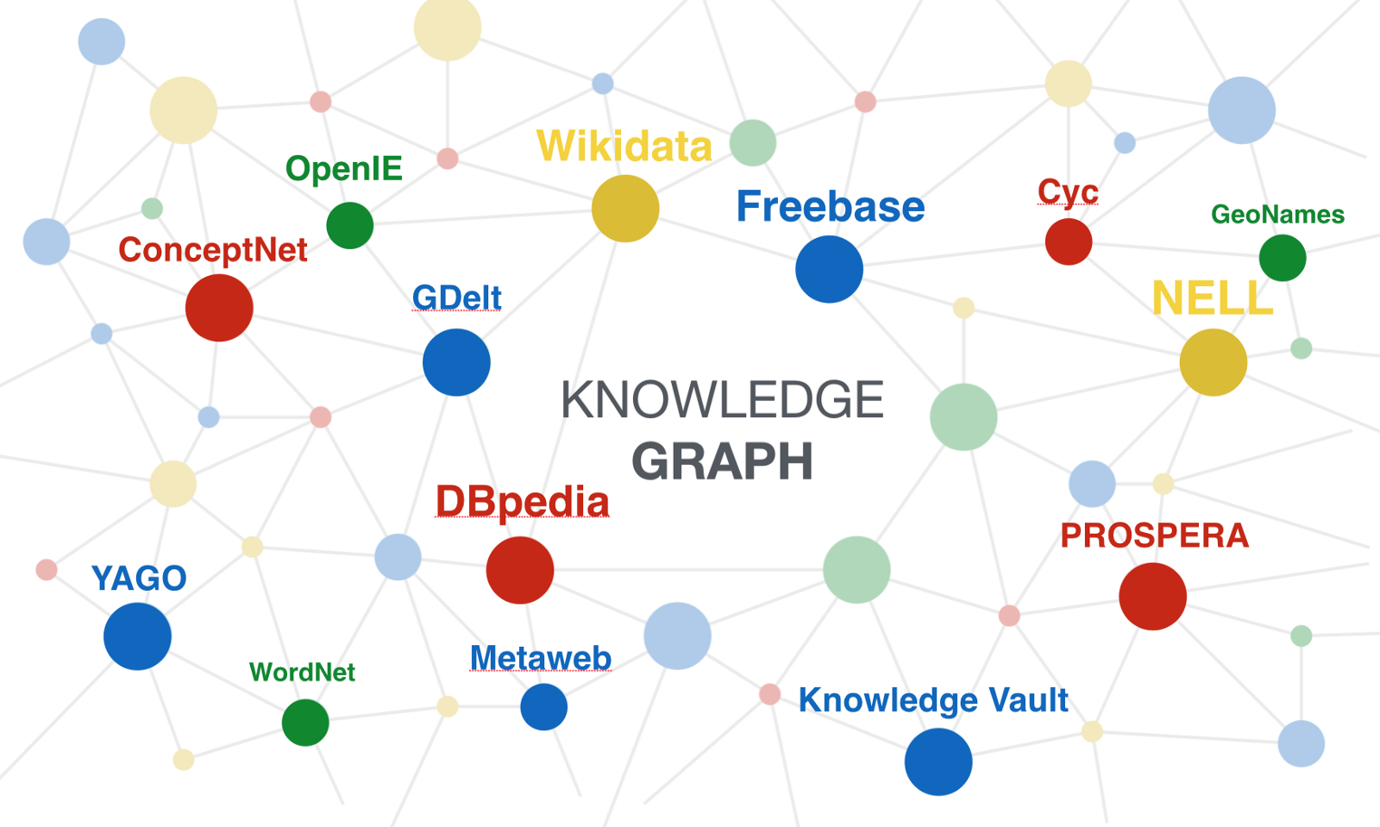
Graph data are everywhere
Social network
Protein/Molecule structure
Knowledge graph

Slide 4
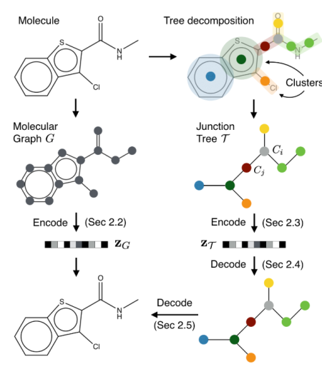
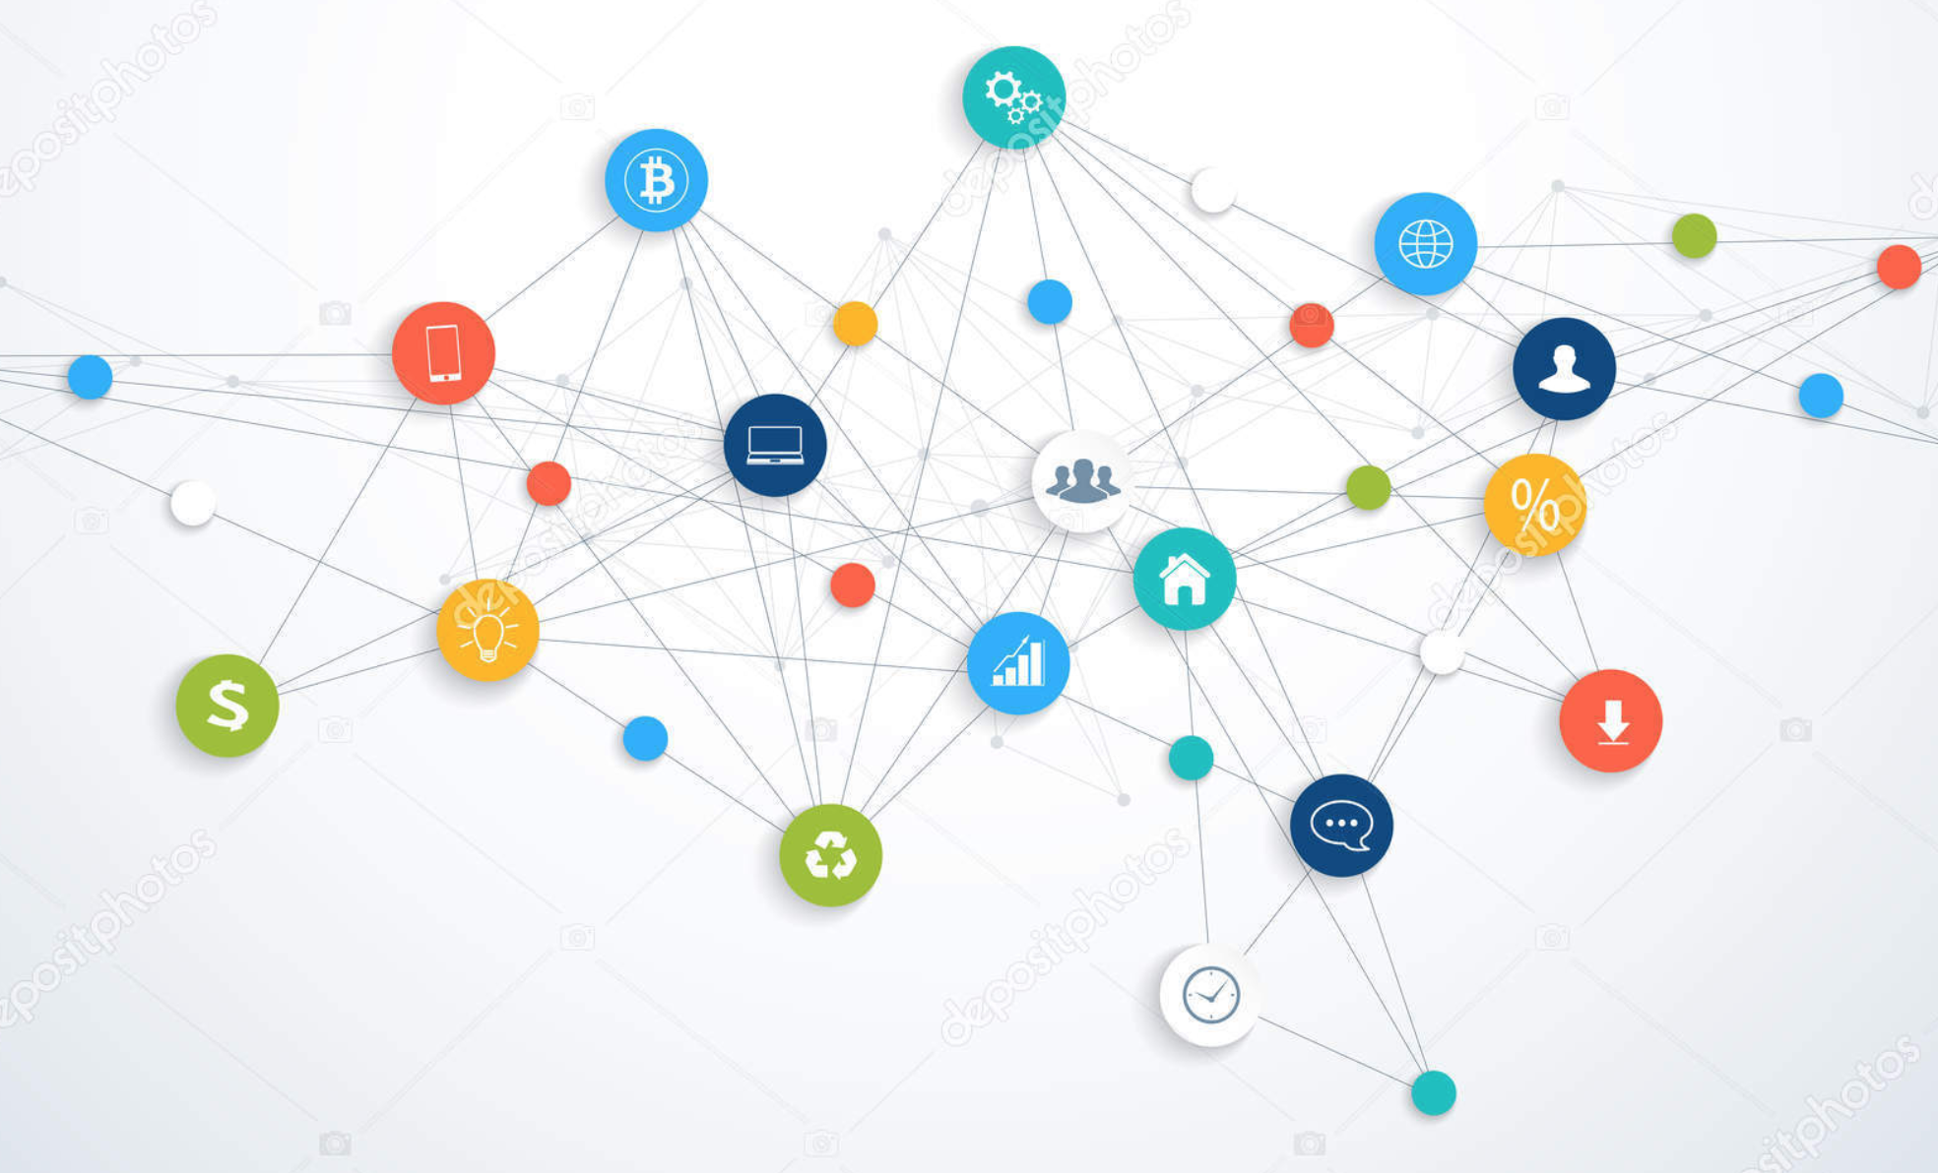
Many ML tasks learn from graphs
Community detection
Find new molecules
Knowledge base completion
Social Network
[Chen et al. arxiv’18]
Molecule Graph
[Jin et al. ICML’18]
Knowledge Base
[Schlichtkrull et al. arxiv’17]

Slide 5
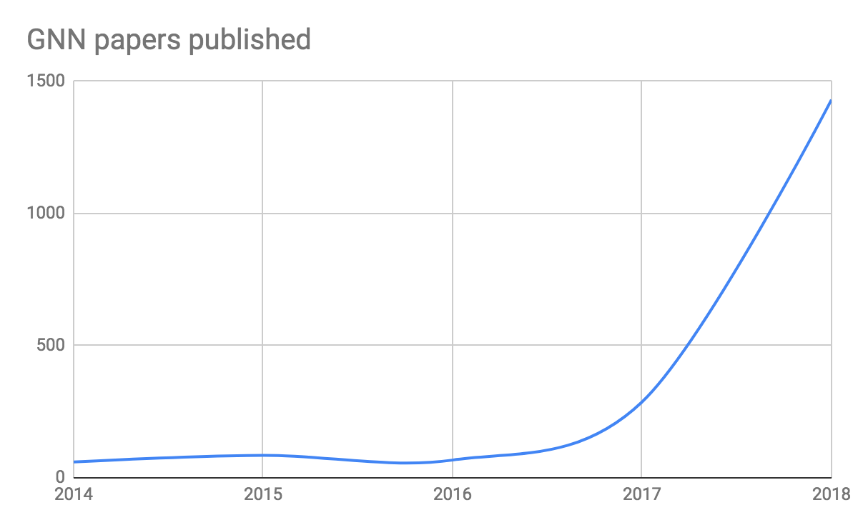
Deep learning + Graph => GNN
Graph Neural Network (GNN) is emerging as an important class of DL models.

Slide 6
What is GNN?
CNN: learn embedding of an image
cat
CNN
Classifier
dog

Slide 7
When deep learning meets graph
Graph Neural Network (GNN): learn embedding on graphs
GNN
Classifier

Slide 8
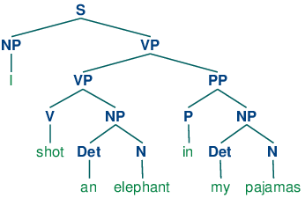
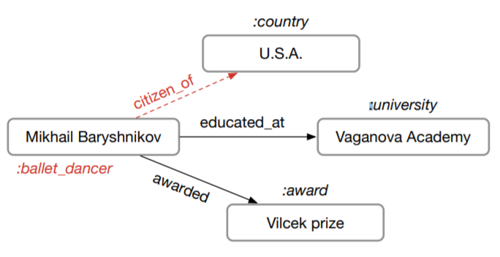
Existing implementations are often slow
Sentence Parse Tree
[Tai et al. ACL’15]
Molecule Graph
[Jin et al. ICML’18]
Knowledge Base
[Schlichtkrull et al. arxiv’17]
Training speed of one popular PyTorch version is only 23 trees/s
Author’s code in PyTorch: 8.25 graphs/s
Cannot run on GPU
due to OOM

Slide 9
Existing tools do not support GNNs well
Writing GNNs is hard in TensorFlow/Pytorch/MXNet.
(Our implementation) caused OOM … which is the reason for the lack of results on Pubmed.
-- from the authors of Graph Attention Network [ICLR’18]

Slide 10
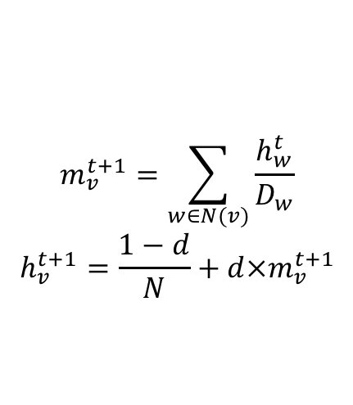
PageRank
PageRank computes the importance of pages.
$$m_{v}^{t+1}=\sum_{w∈N(v)}{\frac{h_{w}^{t}}{D_{w}}}$$
$$h_{v}^{t+1}=\frac{1−d}{N}+d×m_{v}^{t+1}$$

Slide 11
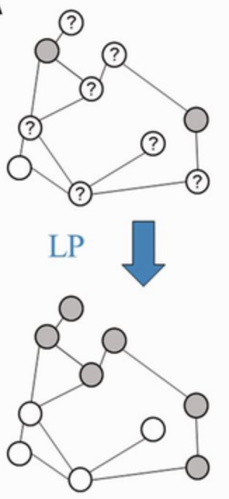
Label propagation
Label propagation can be used for connected components.

Slide 12
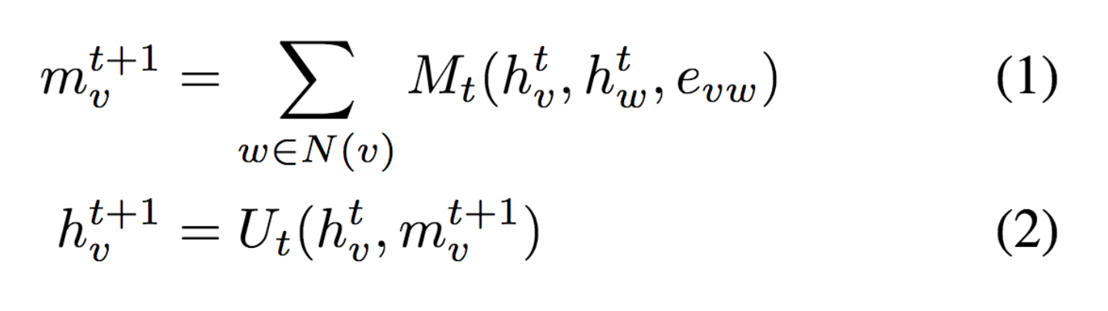

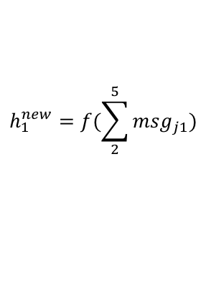
Graph neural networks
GNN with message passing
h₅
h₂
v₅
v₂
$${msg}_{51}^{}=h_{5}$$
v₁
$$h_{1}^{new}=f(\sum_{2}^{5}{{msg}_{j1}})$$
Neural Message Passing for Quantum Chemistry
v₃
v₄
h₄
h₃

Slide 13
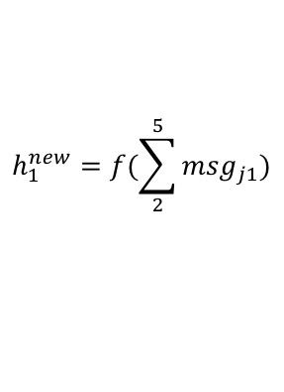
Why is programming GNN hard?
GNN is based on message passing
Tensorflow/Pytorch/MXNet provides tensor programming
h₅
h₂
v₅
v₂
$${msg}_{51}^{}=h_{5}$$
v₁
$$h_{1}^{new}=f(\sum_{2}^{5}{{msg}_{j1}})$$
v₃
v₄
h₄
h₃
How tensors are transformed
On edge: how messages are calculated
On node: how messages are aggregated and consumed

Slide 14
Goals of DGL
Both forward and backward compatible
Fast and Scalable

Slide 15
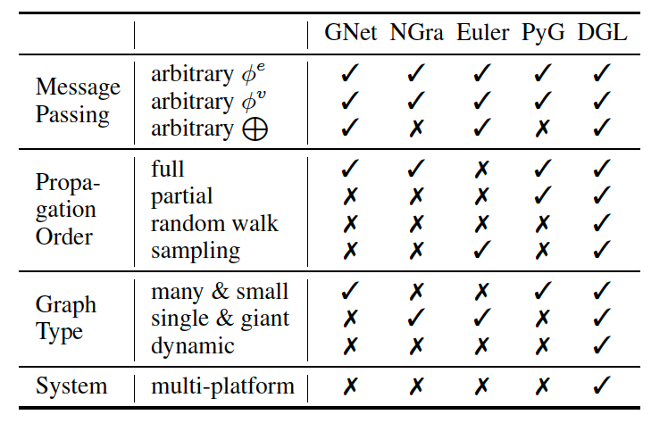
Forward compatibility
Facilitate any models with graph structures
With a very narrow and intuitive APIs, allow
Arbitrary user-defined functions (UDFs)
Flexible message propagation control

Slide 16
DGL Message Passing APIs
3
3
3
3
1
2
1
2
1
2
1
2
4
4
4
4
A graph
send/rcv of a pair
Parallel send/rcv of all pairs
send/rcv of a trajectory
Different levels of controls
Level-1: send, recv
Level-2: send_and_recv, pull, push, update_all
Level-3: propagate

Slide 17
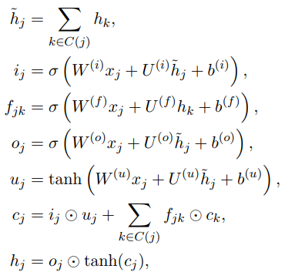
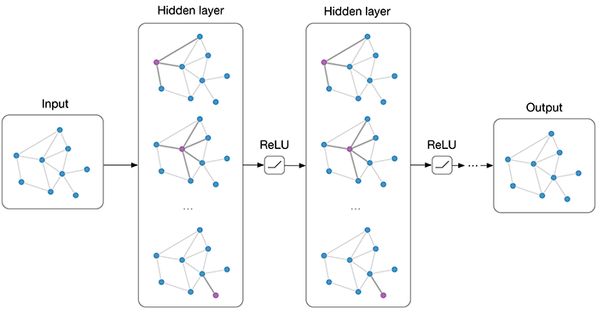
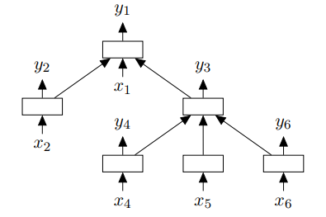
Orders and models
GNN: update all in parallel
Tree-LSTM: update with order

Slide 18
Builtin

Slide 19
User defines functions (on batches of nodes/edges)
u
v
<message>: edge
u.data[‘h’]
(e.src.data[‘h’])
e.data[‘h_e’]
v.data[‘h’]
(e.dst.data[‘h’]
<reduce>: node
v.mailbox[‘m’]
Message function
(edges) -> msg
Reduce function
(nodes) -> new_node_feature
Auto-batched (tensorized)
As if writing for one node/edge

Slide 20
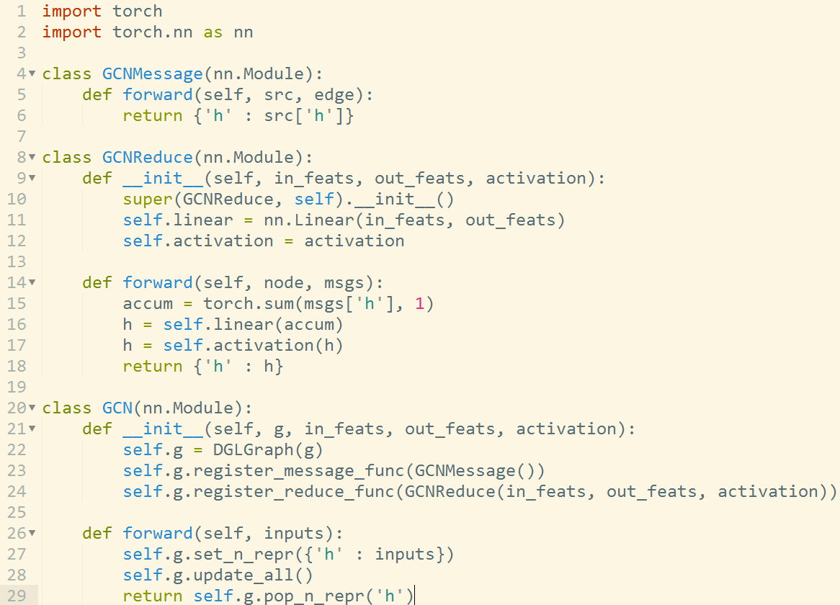
DGL code example: GCN
Tensor for a batch of features
shape=(B, D)
Tensor for a batch of messages
shape=(B, deg, D)
Trigger message and reduce functions for all nodes

Slide 21
Backward compatibility
Platform agnostic
Division of labor
Existing frameworks handle tensor and autograd ops
DGL owns graph storage and optimizes sparse ops
Allows end-to-end integration for platforms of your choice
DGL
Frameworks (TF, Pytorch, MXNet, Keras, …)
Compilers (TVM (Neo), ONNX)
GPU, FPGA, IP core, Arm…

Slide 22
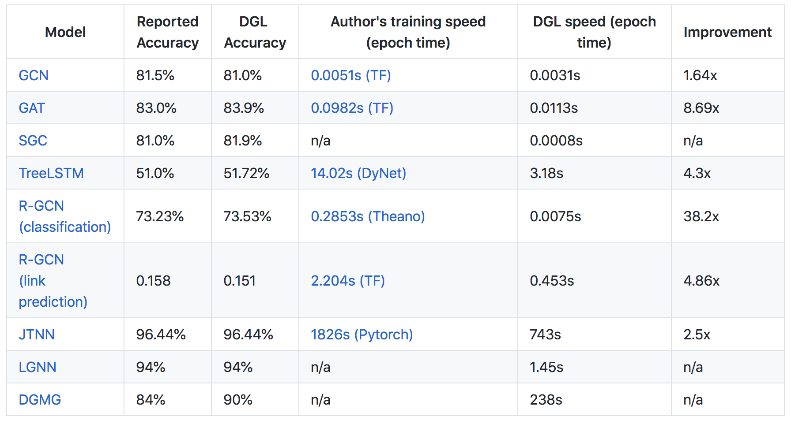
DGL has open-sourced

Slide 23
DGL’s offers
10+ off-the-shelf most popular GNN models (w/ detailed tutorials)
A central repo for 9 popular GNN datasets (cora, pubmed, …)
Easy developing for advanced GNNs:
Sampling for Large graphs
PinSAGE [WWW’18], [Jianfei et al., ICML’18], FastGCN [ICLR’18], …
Dynamic graphs
JTNN [ICML’18], DGMG [CVPR’18], …
Batching of Multiple graphs
TreeLSTM [ACL’15], GAT [ICLR’18], …

Slide 24
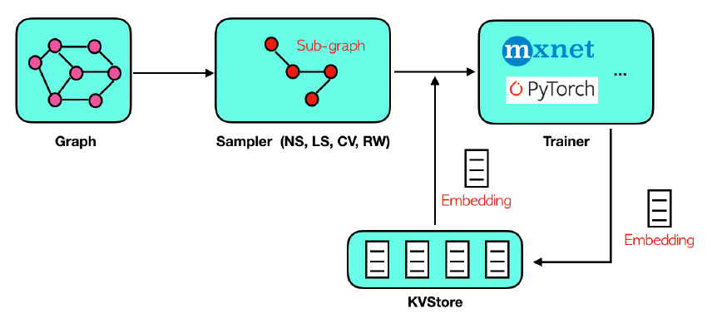
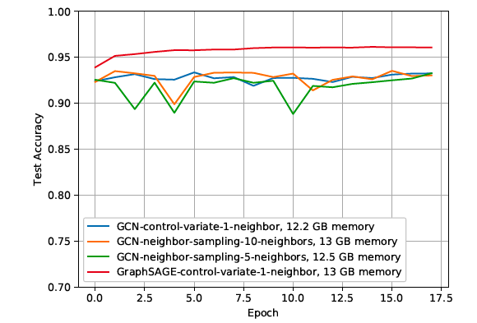
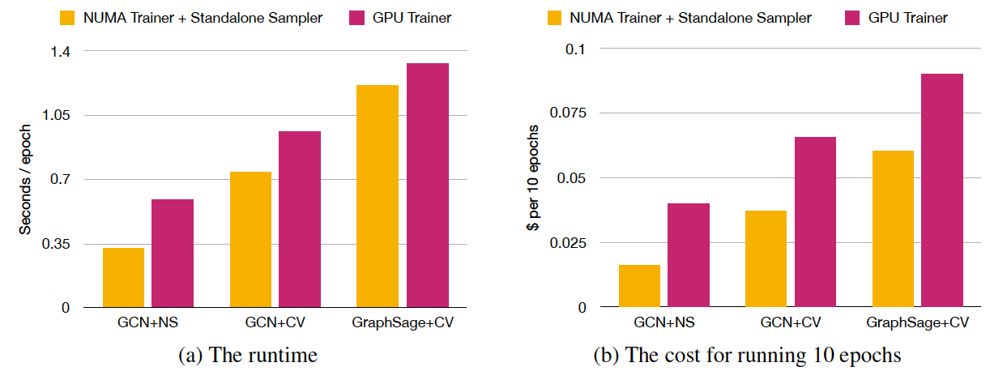
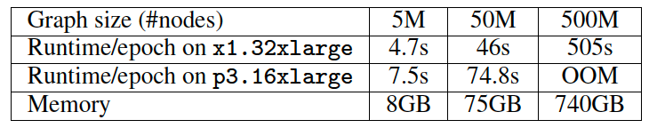
Is DGL scalable?

Slide 25
DGL milestones
v0.1 12/18, v0.2 03/19, v0.3 06/19
~2300 stars, 300+ forks on github, 35K+ package downloads
Twitter followers 1K+, 30 contributors,
Global user base (top 5: US, China, UK, Japan, Indian).
Two hands-on tutorials (NVIDIA GTC 2019, SIGKDD 2019), 10+ blog posts

Slide 26
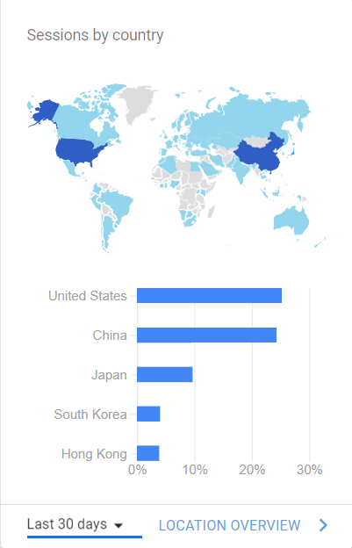
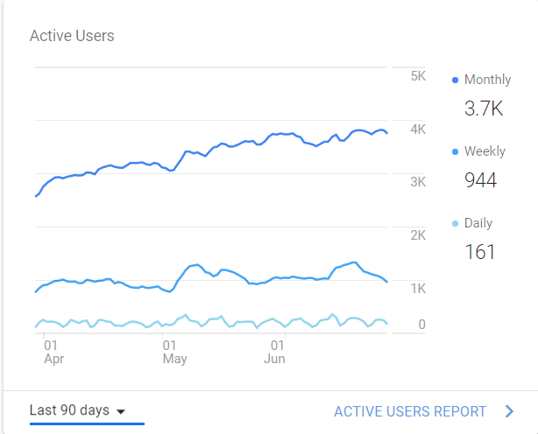
DGL adoption (around the world)

Slide 27
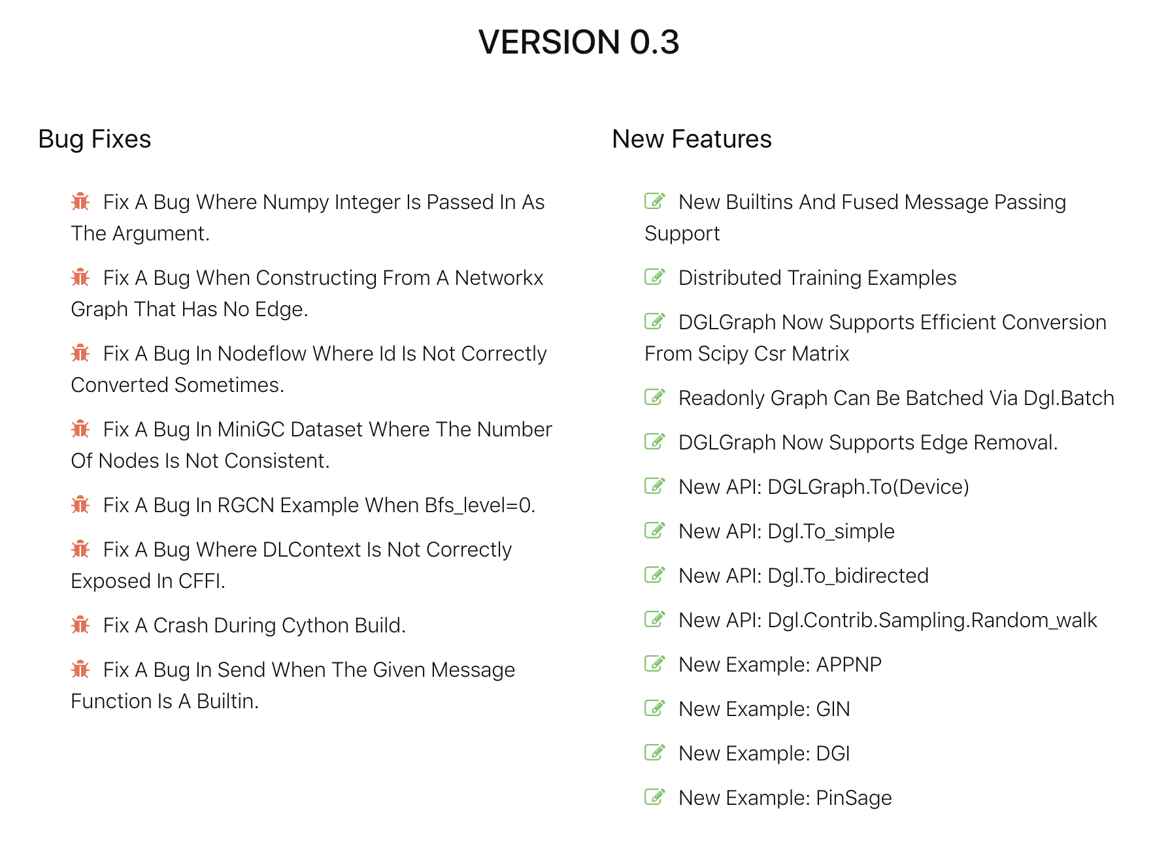
DGL v0.3 features, v0.4 planned

Slide 28
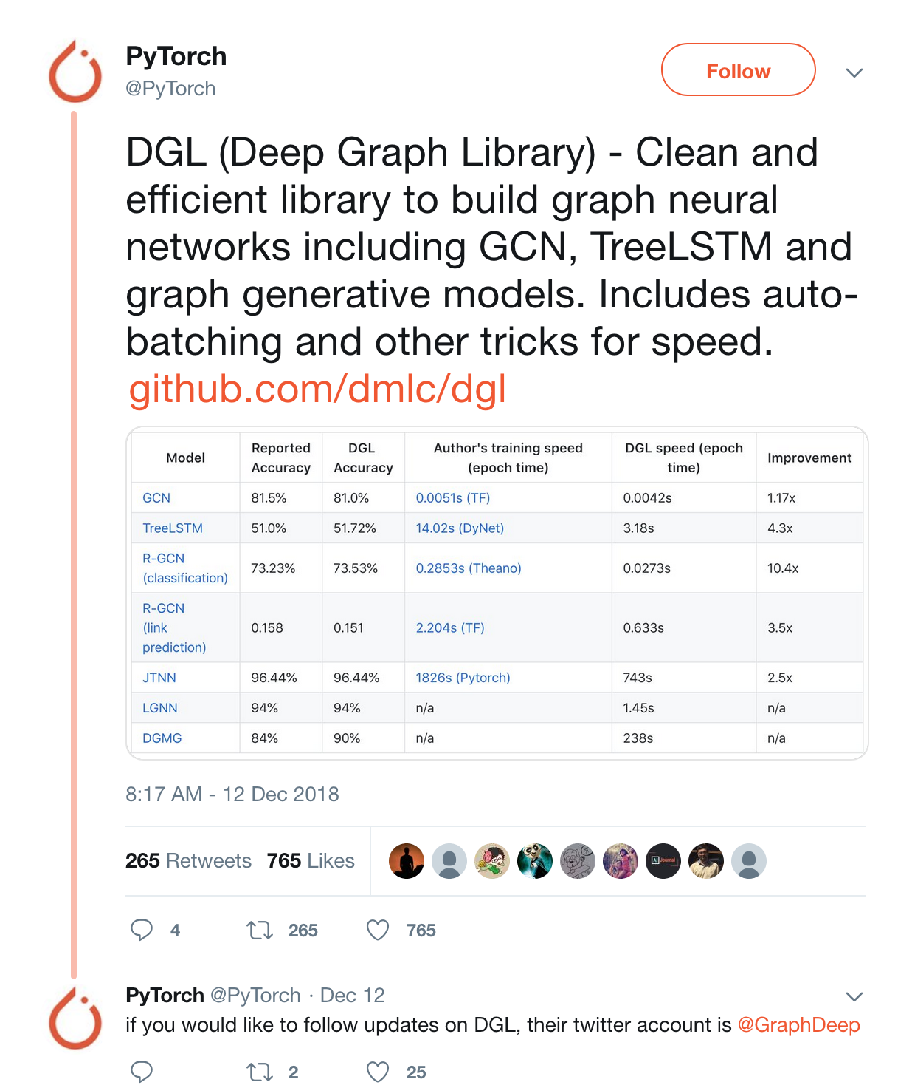
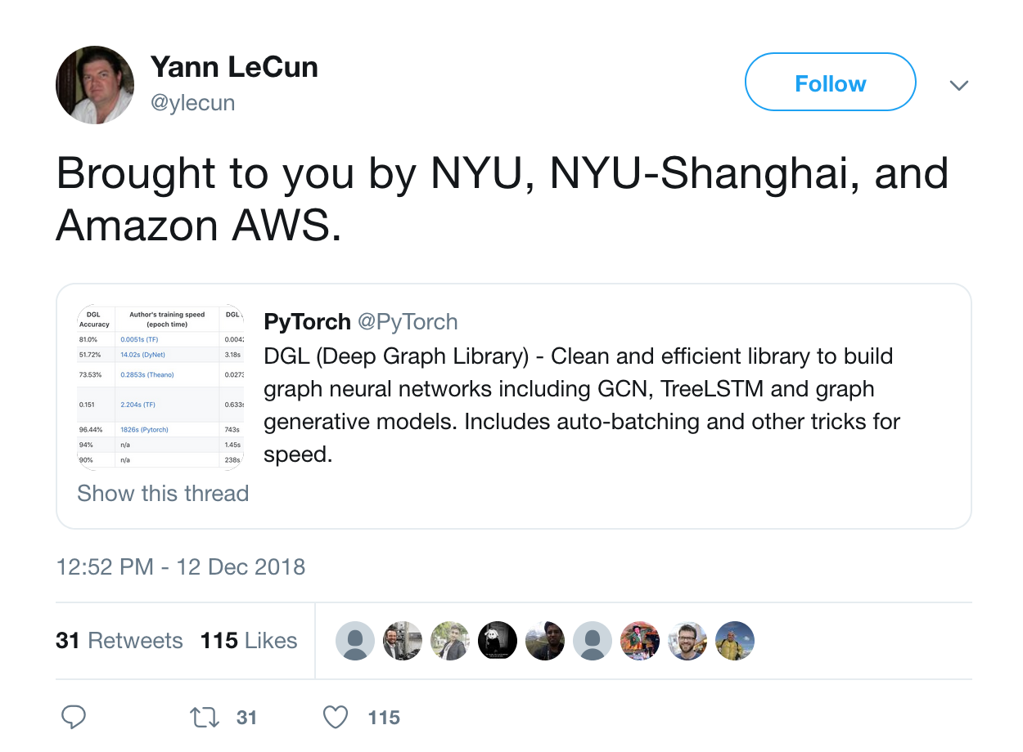
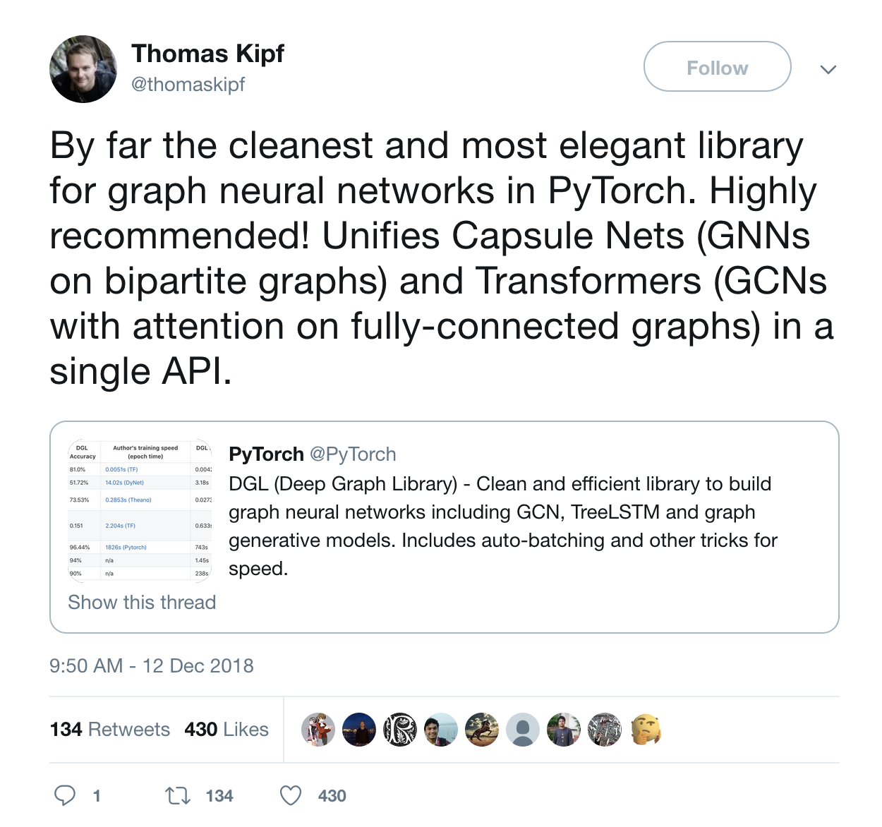
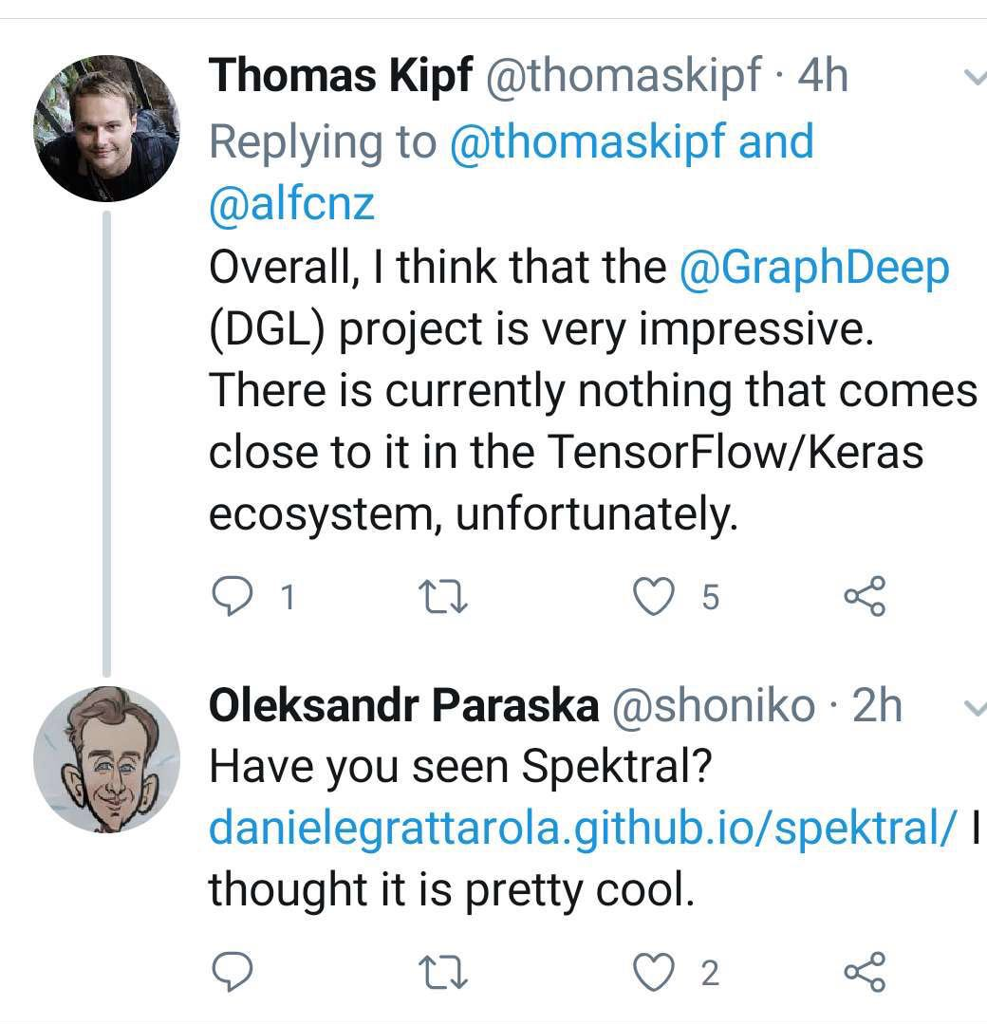

Slide 29
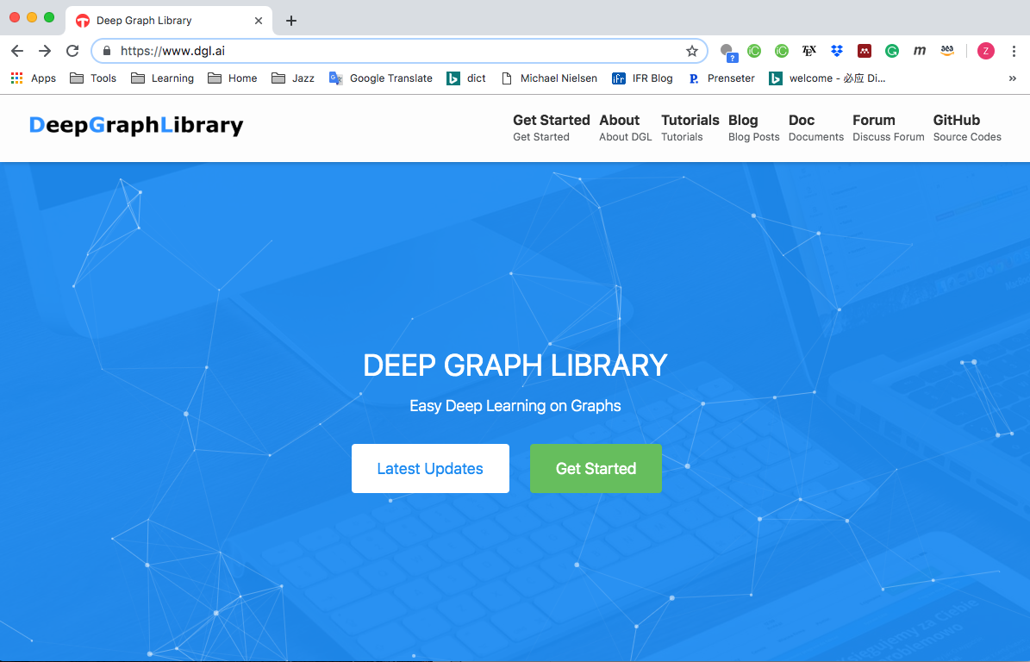
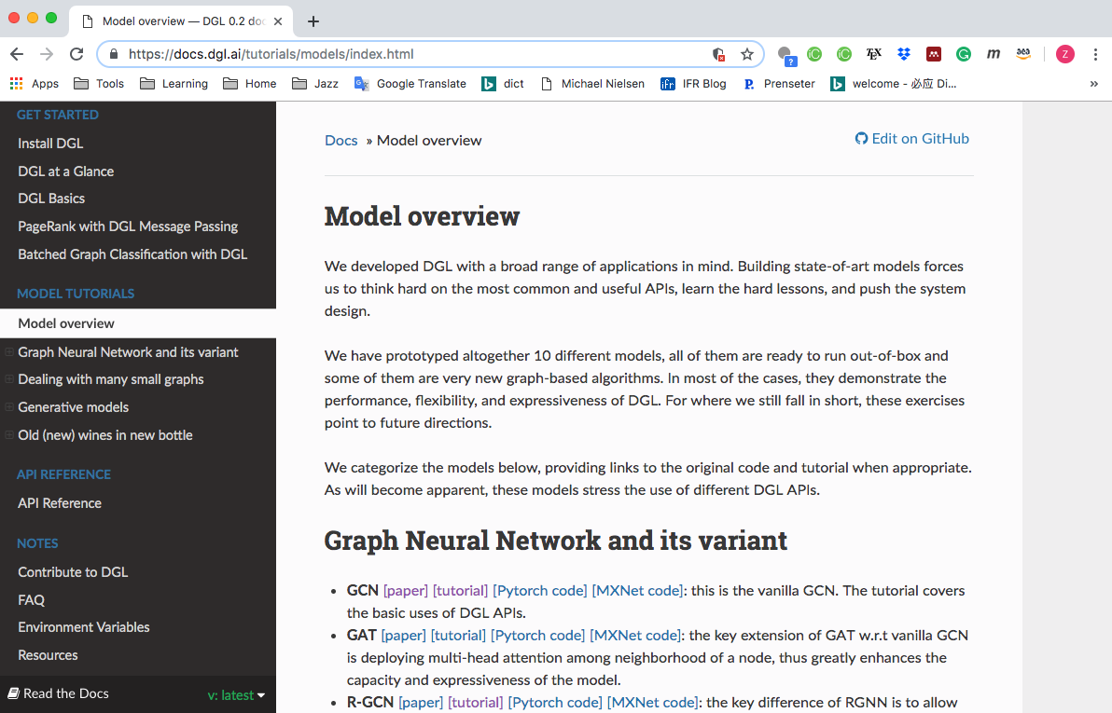
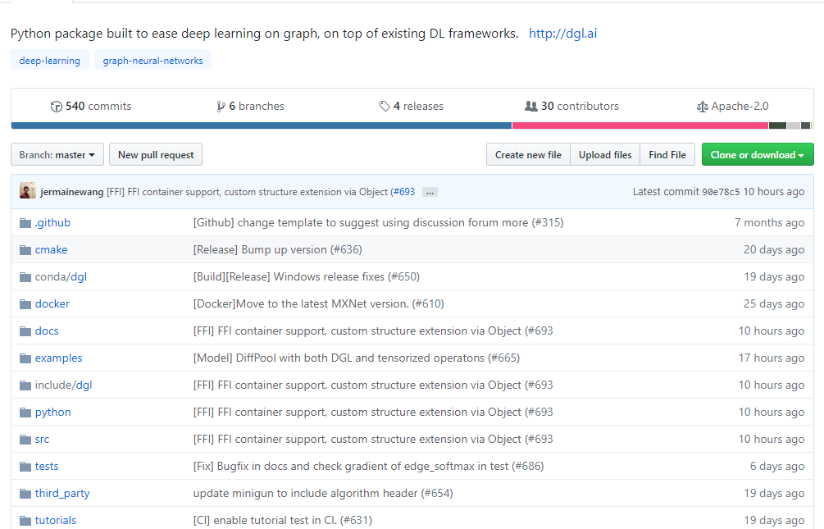

Slide 30
Resources
DGL website: http://dgl.ai/
DGL GitHub Repository: https://github.com/dmlc/dgl
DGL discuss forum: https://discuss.dgl.ai/
Please try it! And we hope to see your contributions!!

